Slide 1
Motivation and Bias: Strategies for Developing Greater Self-Awareness and Observational Skills
Tricia Naddaff + David Ringwood, MRG

Slide 2
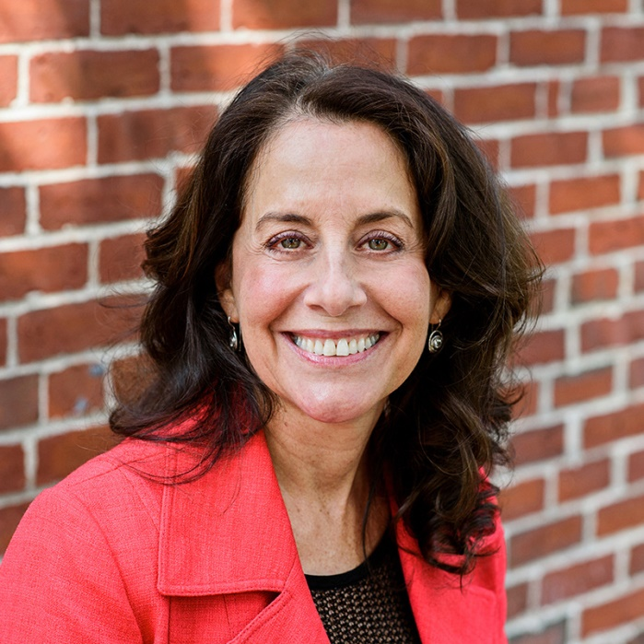
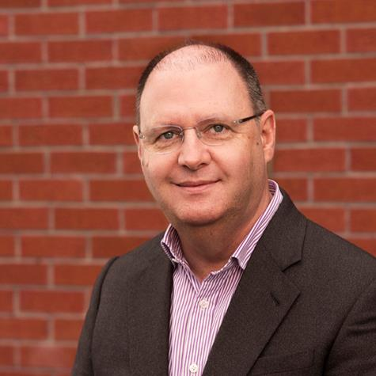
Tricia Naddaff
President, MRG
David Ringwood
VP of Client Development, EMEA
Management Research Group is a global leader in designing assessments that foster a deep self-awareness and impact people in profound and meaningful ways with solutions for Leadership, Personal Development, Sales and Service.
MRG conducts extensive research on effective leadership behavior, leveraging a database of more than 1.2 million assessment participants.

Slide 3
Motivation and Bias: Strategies for Developing Greater Self-Awareness and Observational Skills

Slide 4
Today’s Agenda
Brain Basics
Understanding Bias
Motivation and Bias
Dealing with Bias

Slide 5
Poll Question
How frequently are you talking with your clients about bias?
a. Frequently - bias is discussed regularly
b. Somewhat frequently - beginning to work with it more regularly
c. Only occasionally is bias discussed
d. Very rarely (or maybe even not at all…yet)

Slide 6
Understanding the Brain

Slide 7
Keep Us Safe

Slide 8
Threat Sensitive

Slide 9
Conserve Energy

Slide 10
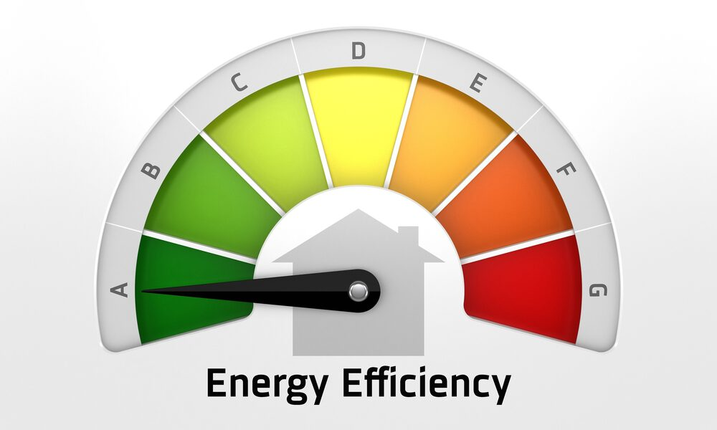

Slide 11
Two Brain Patterns
Continually scanning
Always on
Fast but error prone
Works automatically
Uses shortcuts, impulses and intuition
Mechanisms use little energy
Thinking Fast – Older Brain
Thinking Slow - PFC
Used for specific problems
Has to be “turned on”
Slow but reliable
Takes a lot of effort
Solves complex problems and uses self control
Mechanisms use a lot of energy
Thinking, Fast and Slow by Daniel Kahneman

Slide 12
An Example of a Shortcut
Who is driving?

Slide 13
Understanding Bias

Slide 14
If you have a brain…
you’re biased.

Slide 15
Every second, our brains…
ENCOUNTER roughly
11 million pieces of information
CAPTURE
50
pieces of information
PROCESS
7
pieces of information

Slide 16
Understanding Bias
Our brains are constantly taking shortcuts to fill in the blanks.
And in these short cuts are our biases.

Slide 17
Understanding Bias
These shortcuts result in unconscious decisions.
Many of these unconscious decisions are wrong.
This is especially true if the problem or issue is complex…
like another person.

Slide 18
Understanding Bias
Biases allow our brains to make snap judgements about people before we have a conscious thought.
And our brains make these decisions about people based on a small amo of information.
Then our brains extend that decision to their whole character.

Slide 19
Understanding Bias
Often, our brain’s decision-making circuits try to cover up our lack of knowledge about the other person.
This results in a level of overconfidence that our perceptions are accurate.

Slide 20
If you have a brain…
you’re biased.

Slide 21
Examples: Cognitive Biases
Confirmation Bias
Semmelweis Reflex
False Consensus Effect
Fundamental Attribution Error
Illusion of Transparency
Stereotyping

Slide 22
What amplifies bias?
Speed, complexity, stress and cognitive overload increase the influences of cognitive biases.

Slide 23
Picture this Exercise
Notes:
Let’s do a quick exercise that will demonstrate how the brain does this.
Please close your eyes (or soften your gaze and look down at the floor).
Now please picture these people.
A judge in a robe
A pilot
A nurse taking care of a patient
Ok open your eyes and take a few minutes to share with one or two people at your table the description you envisioned of these people.
Coming back together – how quickly and specifically where you able to visualize these people? For most if not all the pictures came quickly, easily and with a fair amount of detail.
Likely you did not stop to wonder if the judge was:
An Olympic judge
A regional fair judge
A courtroom judge
An election judge
A pageant judge
A livestock judge
Or a student judge
You didn’t stop to wonder if the judge was in:
A bathrobe
A ceremonial robe
A jedi knight robe
A monk robe
A medieval robe
A royal robe
An you probably didn’t stop and think about all the variations about this person including:
Gender, age, height, weight, hair/skin color
A picture just appeared. Given all the choices, all the options, how did your brain come up with that picture?

Slide 24
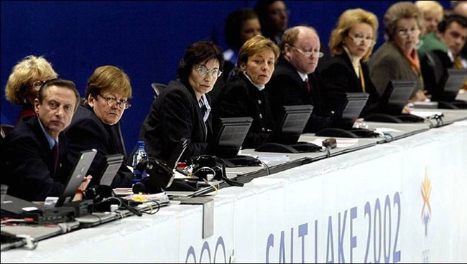
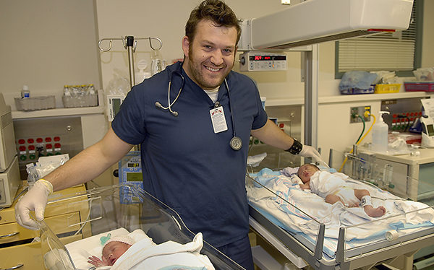
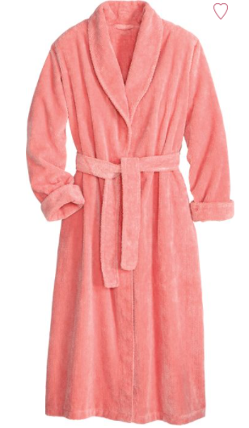

Slide 25
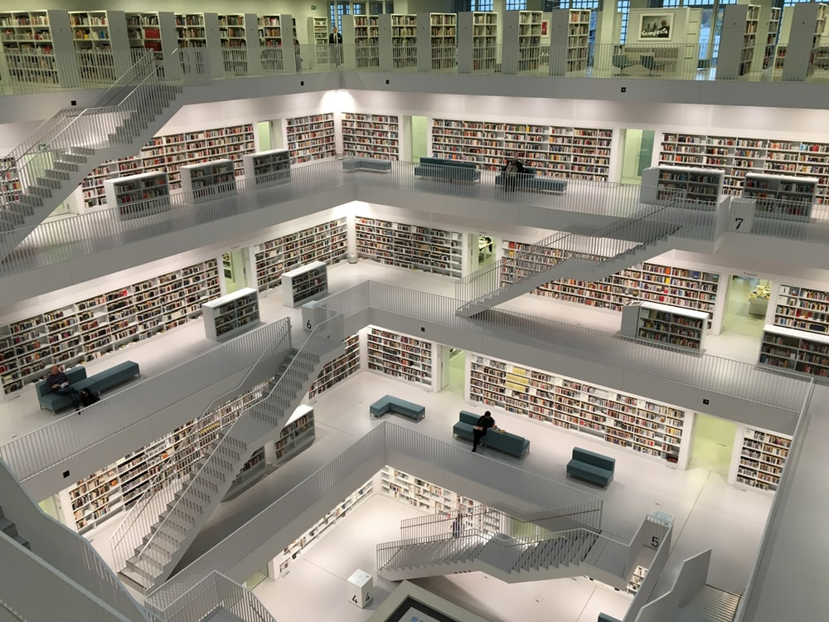
Your Unique Brain Database
Notes:
These choices are made based on our own unique databases in our brain. What we’ve been exposed to and how frequent our exposure has been.
While we are not prisoners of this. We can bring our PFC and higher order thinking back online by saying “wait a minute – what else may be true, or possible, or should be considered?” but that takes brain energy that our brains would rather we didn’t consume so off on our automatic way of thinking we go without even realizing that we’re doing it.

Slide 26
Group Exercise – 12 minutes
In groups of three
Discuss
Your images
How your database has been built to generate these
How you have/may talk to your clients about their unconscious biases

Slide 27
Questions
& Comments

Slide 28
Motivation and Bias
…and why it matters.

Slide 29
Understanding our deeper drivers
Motivational factors originate from the formative years and evolve slowly over time.
While we may recognize our own behavior quite easily, some people are less in touch with these deeper underlying drivers.
Notes:
As we think about motivation, bear in mind the following considerations:

Slide 30
Understanding our deeper drivers
Many people will be surprised by a few of their IDI scores.
It is truly difficult to have a fully objective view of ourselves.
Notes:
As we think about motivation, bear in mind the following considerations:

Slide 31
Understanding our deeper drivers
People with extreme scores are very likely to underestimate this extremity.
They may have normalized it to the extent that it becomes less evident to them.
Notes:
As we think about motivation, bear in mind the following considerations:

Slide 32
IDI Dimensions – Measuring Motivation
AFFILIATING
Giving
Receiving
Belonging
Expressing
ATTRACTING
Gaining Stature
Entertaining
PERCEIVING
Creating
Interpreting
MASTERING
Excelling
Enduring
Structuring
CHALLENGING
Maneuvering
Winning
Controlling
MAINTAINING
Stability
Independence
Irreproachability

Slide 33
“In the past two decades, the time spent by managers and employees in collaborative activities has ballooned by 50%
or more.”
Harvard Business Review, Jan/Feb 2016. “Collaborative Overload.”
Cross, Rebele & Grant.

Slide 34
At many companies, employees spend about 80% of their time interacting with others – in meetings, on the phone, or responding to emails.
Harvard Business Review, Jan/Feb 2016. “Collaborative Overload.”
Cross, Rebele & Grant.

Slide 35
Examples of Bias Effect categories
Potential Mindset Effects
Oppositional mindset (me versus you)
“Never good enough” mindset
Potential Interpretive Biases
Everything is a competition
Giving up is an admission of defeat
Potential Assumption-based Thinking
There’s always a hidden agenda
The facts speak for themselves
Potential Estimation Errors
Under-estimation of the support needs of others
Under-estimation of other people’s sensitivity to conflict
Potential Attribution Errors
Attributing negative intent to others, projecting

Slide 36
Examples of Motivational Biases

Slide 37
The motivation to Give
When someone is high on the motivation to give, they may think…
“Everyone wants my help.”
(Assumption Bias)

Slide 38
The motivation to Maintain Autonomy
When someone is highly motivated to be self-sufficient, they may think…
“Support is just an attempt to interfere and take control.”
(Interpretive Bias)

Slide 39
The motivation to Achieve and Succeed
When someone is highly motivated to achieve and succeed, they may think…
“It’s never good enough”
(Mindset Bias)

Slide 40
The motivation for External Recognition
When someone has less motivation for external recognition, they may think…
“They don’t want a lot of praise or fuss about their accomplishments.”
(Estimation Error)

Slide 41
Examples of multiple bias effects: Interpersonal Dynamics
Sensitive to feeling unsupported
Sensitive to feeling ignored
Sensitive to feeling unappreciated or under-recognised
Sensitive to feeling isolated or excluded

Slide 42
Exercise slide – 12 minutes
Sensitive to feeling unsupported
Sensitive to feeling ignored
Sensitive to feeling unappreciated or under-recognised
Sensitive to feeling isolated or excluded
What are my unique sensitivities?
Which are greatest/least?
How do they show up in your world?

Slide 43
Questions
& Comments

Slide 44
How to deal with biases
5 strategies to mitigate the impact of bias

Slide 45
Mitigate the Impact of Bias
1
Increase awareness
2
Take Time to Reflect
3
Slow down
4
Break the habit cycle
4
Break the habit cycle
5
Expand your database
Notes:
Know your triggers – internal and external triggers that increase stress increase the likelihood your brain will default to automatic thinking
Reflecting engages the process of metacognition – thinking about our own thinking which allows you to think about where you are likely to be biased and also where you have experienced bias toward you.
Slow down – speed favours automatic thinking. Take time to engage your PFC with questions and alternative considerations
Break your habitual way of thinking by some simple strategies like imagining you are solving this issue for a friend or imagining extending the time you have to deal with the issue – how would you solve it next year.
Expand your database by consuming different information and talking to different people

Slide 46
Mitigate the Impact of Bias
1
Increase awareness.
Become aware of motivations.
Identify internal triggers
Identify external triggers

Slide 47
Mitigate the Impact of Bias
2
Reflect.
Look back at past decisions
When have you experienced bias directed toward you?
How have others experienced your biases directed at them?

Slide 48
Mitigate the Impact of Bias
3
Slow down.
Take three deep breaths
Sleep on it
Take time to get to know people more completely.

Slide 49
Mitigate the Impact of Bias
4
Break the habit cycle.
Invite a different perspective
Ask for feedback
Be curious, ask questions

Slide 50
Mitigate the Impact of Bias
4
Break the habit cycle.
Use your imagination.
How would I advise someone else about the decision?
How would I decide this a year from now?

Slide 51
Expand Your Brain Database
Notes:
These choices are made based on our own unique databases in our brain. What we’ve been exposed to and how frequent our exposure has been.
While we are not prisoners of this. We can bring our PFC and higher order thinking back online by saying “wait a minute – what else may be true, or possible, or should be considered?” but that takes brain energy that our brains would rather we didn’t consume so off on our automatic way of thinking we go without even realizing that we’re doing it.

Slide 52
“Knowing yourself is the beginning of all wisdom.”
- Aristotle

Slide 53
Questions
& Comments

Slide 54
Resources ….
Resources
Your Brain at Work
Blind Spot: Hidden Biases
Thinking, Fast and Slow

Slide 55
Thank you. Stay in touch.
research@mrg.com

