Slide 1
The Ethics of Coaching Ethical Mindset: Recognizing ‘hot water’
Don’t be a Frog!
Dr. Pat Williams, MCC
Master Coach, Transformational Living

Slide 2
Outline
Ethical decision-making process
Utilize decision-making model
Reference ICF ethics codes
Case scenarios for consideration
ICF ethics complaint procedure
How to be consciously competent
© 2022 Dr. Pat Williams www.DrPatWilliams.com

Slide 3
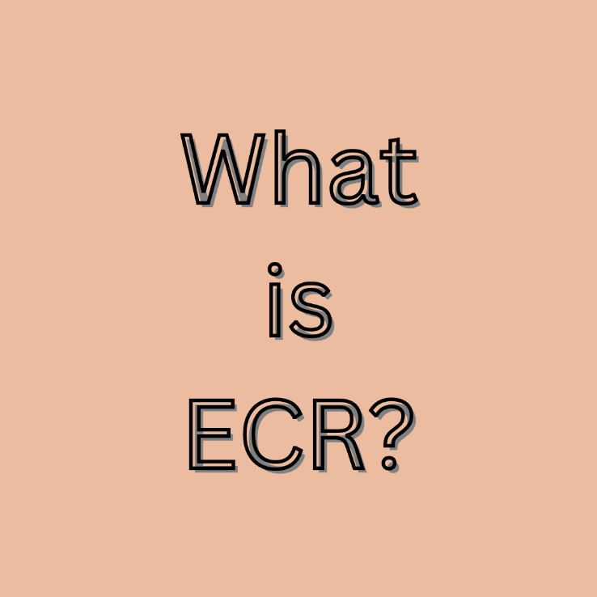
Ethical complaint process
Read and review ICF ECR process sheet
What is IRB? What is ECR?
© 2022 Dr. Pat Williams www.DrPatWilliams.com

Slide 4
Scope of practice
Making recommendations to clients
Melding prior career knowledge into coaching frame
© 2022 Dr. Pat Williams www.DrPatWilliams.com

Slide 5
Ethical Guidelines and Their Usefulness
ICF Ethical Conduct
ICF review process
Discipline and remedial outcomes
© 2022 Dr. Pat Williams www.DrPatWilliams.com

Slide 6
Staying out of Hot Water
Client Selection
Contracting
Confidentiality
Conflict of Interest
© 2015 Dr. Patrick Williams

Slide 7
Staying out of hot water and sticky situations
Record keeping and peer consultation
Client agreement?
Client selection and clarity of role
© 2022 Dr. Pat Williams www.DrPatWilliams.com

Slide 8
The 6 R’s for Ethical Practice
Rights
Respect
Recognition
Relationship
Representation
Responsibility

Slide 9
ETHICAL DECISION- MAKING MODEL
Conditions for Success
Clarify
Evaluate
Decide
Implement
Modify and Monitor
Document, document, document
© 2022 Dr. Pat Williams www.DrPatWilliams.com

Slide 10
A Relationship of Experts
The Coach is the expert on the coaching process
The Client is the expert on his or her life and the content of the coaching session.
© 2022 Dr. Pat Williams www.DrPatWilliams.com

Slide 11
“Remember that in matters of professional ethics,
ignorance is not bliss.”
~ Mathilda B. Canter
© 2015 Dr. Patrick Williams

Slide 12
Let’s do some Case Reviews
Break out discussions

Slide 13
Open Forum Question
What questions have come to mind from today’s review?
© 2015 Dr. Patrick Williams

Slide 14
Thank You!
c
Thanks for being who you are
so you can do what you do
and inspire others to do the same..
O.
© 2022 Dr. Pat Williams www.DrPatWilliams.com

Slide 15
Getting Naked: On Being Emotionally Transparent
at the Right Time, the Right Place, with the Right Person
New ICF approved for 24 CCE hours: www.ConsciousLivingMastery.com
Ways to Uncover your Authentic Self, at Work, at Home, In Relationships, and Life
A personal teaching memoire of a life well lived and what others can learn from honesty at the right time and place.
© 2022 Dr. Pat Williams www.DrPatWilliams.com

