Slide 1

ICFLA
Building Emotional Intelligence
Teams & Leaders

Slide 2
Presentation Agenda
Managing Reactivity
  Reactivity in the pandemic and post-pandemic space
  Managing reactivity as a gateway to EI
  Personal patterns of reactivity – Tools for regaining center
  Empowering and Centering Through Empathy
    Don’t just do something…Stand there!
    Maximize self-awareness before acting
  Q&A

Slide 3
Warm Up

Slide 4
Stimulus and Response
“Between stimulus and response there is a space
Within that space lies our freedom and power to choose our response
Within those choices lie our opportunities for growth and happiness”
– -Victor Frankl

Slide 5
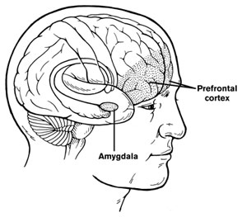
Reactivity and the Brain
Fight or flight
Tend or befriend

Slide 6
Hold
Box Breathing
In
Out
Hold

Slide 7
Conviction/Connection Model
Rigid
Conviction
Enmeshed
Cut-off
Connection
Wishy-washy

Slide 8
Empathetic Listening
  Assume positive intent
  Be genuinely curious
  Put yourself in the other person’s shoes - Look out at the world through his or her eyes
  Unpack the other person’s experience through questioning (Mush Separator)
  Treat the other person as an expert to his or her experience
  Don’t spike the ball! Don’t Give Advice. Don’t solve the problem

Slide 9
Empathy Tools
Parrot
Paraphrase (Accuracy Check)
Paraphrase Plus

